Slide 1
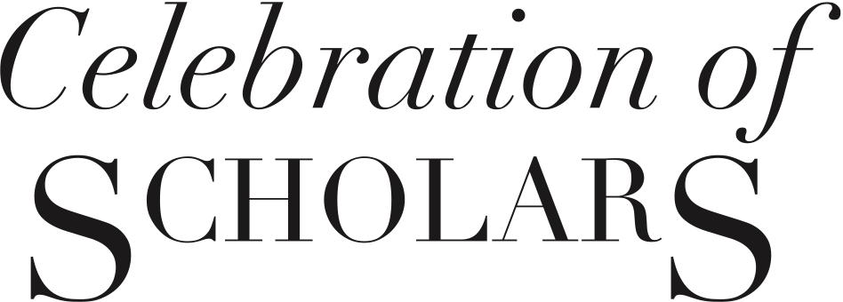
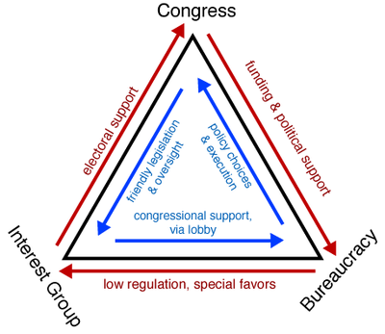
Defending the Application of the Federal Bureaucracy:
A Case for Bureaucracy
Hunter Douglas
Department of Political Science, Carthage College
Celebration of Scholars 2013: Exposition of Student and Faculty Research, Scholarship and Creativity
Abstract
The aim of this research project was to explore to what extent the federal bureaucracy is effective in the United States representative democracy. The project explores to what end the federal bureaucracy can be more effective than the established representative form. The paper focuses on the federal bureaucracies within the United States and their interactions with the other democratic institutions including the legislative branch, the executive branch, and the judiciary branch. Research was carried out by examining the works of predominate political theorists and by examining the results that federal bureaucracies have achieved in implementing policy. The results of this study tell us that in some cases the federal bureaucracy is preferable in the process of policy implementation than that of classic representative democracy. Through the study it is recommended that the federal bureaucracies continue to work alongside the other democratic institutions so each can continue to benefit from one another. After evaluating the data and research we find that although critics of bureaucracy are opposed to bureaucratic government because it seems to challenge their ideals of democracy, these systems are important to modern societies, and when used properly lead to better policy than would come from a more conventionally democratic system.
Results and Discussion
By examining the history of the federal bureaucracy, the characteristics of the federal bureaucracy, examples of the bureaucracies at work, and by challenging the arguments against bureaucracies it is reasonable to determine that the federal bureaucracies are an important aspect of the American democratic system, can lead to better policy outcomes than classic representative government, and benefit the system as a whole when applied correctly. First by looking at the growth of the federal bureaucracy through history it can be seen that federal bureaucracy as it functions today is a result of the demands of the people. Over time the issues that the American government faces have grown in complexity and the scope of issues that need addressed have grown as well. Because of this rising complexity and number of issues that the American government faces the federal bureaucracy has grown with it in order to effectively and efficiently solve important issues. When the characteristics of a bureaucracy are examined it becomes clear that there are policy types or requirements that would benefit from a bureaucratic control. Policies that require a high level of oversight are ideal for bureaucratic control because they have enough physical resources to effectively implement policy. Next polices that require expert consideration are also more ideal for bureaucratic control, this is because by nature the federal bureaucracies are filled with issue specific experts who are best suited to respond to highly technical and complex social issues. Next polices that have either clear or open stated goals can be ideal for a bureaucracy to control. This characteristic can be seen in the success that polices with clearly state goals such as the Pure Food and Drug Act and polices that have loosely defined goals such the Clean Air Act; both of these policies are implemented by a federal bureaucracy and both have been highly successful and implementing the stated policy goals. Finally if claims made against the use of bureaucracy are challenged it is possible to conclude that its negatives attributes are not as bad as some make them out to be. Some believe that the federal bureaucracy is too large, but the bureaucracy is its current size because of the demands and needs of the people. Bureaucracies are also blamed for being slow and full of conflict, but by design so is much of the American government; this conflict ensures decisions are being made with some consideration. Last is the claim that the bureaucracy is unresponsive to outside forces and value judgments, though in some cases this characteristic is actually one of the bureaucracy’s best attributes. It is important for the bureaucracy not to take an outside or value laden view on a policy decision so that it will be consistent and act in accordance to the policy goals. Because of the characteristics of the federal bureaucracy I find that when paired properly with certain policy types the system can lead to better policy outcomes than classic representative government and benefit our system as a whole.
2000
1650
1000
850
650
500
400
300
200
100
Introduction
American politics have become more intertwined and connected than ever before. Americans live in an environment in which every area of policy is affected and influenced by one another. The American government has evolved greatly in complexity since its inception by the founding fathers; this evolution has caused a rise in the importance of bureaucracies within the modern government. This evolved and more complex state raises questions about the degree to which bureaucratic policy control is preferable to a form of classic representative democracy. The legislative branch is making complex policy decisions of a kind that it was not anticipated to; an example of this is complex environmental impacts and balancing economic progression against environmental sustainability which could not have been foreseen by the Founding Fathers. The issues that the Congress faces and enacts bills regarding are now regularly very complex and interconnected; today there is a need for expert influence in each field so that issues are competently understood and to ensure these high level decisions are being made properly. Although critics of the federal bureaucracy are opposed to a bureaucratic government because it seems to challenge their ideals of democracy, these systems are important to modern societies, and when used properly lead to better policy than would come from a more conventionally democratic system.
Acknowledgements & References
A special thanks goes to faculty advisors Jeffrey Roberg and Jerald Mast,
as well as Natalie Ceis for hours of peer edits and motivation.
Anderson, Simon and Peter Mortensen. 2010. “Policy Stability and Organizational Performance:
Is there a Relationship?” Journal of Public Administration Research and Theory
20(January).Munro, Sean, Thomas, KL, Abu-Shaar, M. (1993) Nature 365, 6-65
Bennis, Warren. 1968. Beyond Bureaucracy. New York, NY: John Wiley & Sons
Dryzek, John. 1990. Discursive Democracy. New York, NY: Cambridge University Press.
Simon, Christopher. 2007. Public Policy: Preferences and Outcomes. United States: Pearson
Education.
5. Wilson, Woodrow. 1887. "Study of Administration." in Classics of Public Administrators, eds.
Jay Shafritz, Albert Hyde, and Sandra Parkes.Belmont, CA: Wadsworth.
Figure 1. Iron Triangle of American Politics

